Slide 1

STUDY OF STRENGTH CHARACTERISTICS OF CONCRETE USING RECYCLCED MATERIALS
Under the esteemed guidance of
D.SAMPATH SIR
DEPARTMENT OF CIVIL ENGINEERING
H.O.D J.Ravi kumar sir

Slide 2
TOPIC
RECYCLE OF COARSE AGGREGATE

Slide 3
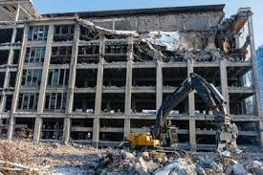

Slide 4
CONTENTS
Introduction
Demand of aggregate on construction
What is recycled concrete aggregate(RCA)
Benefits of RCA
Procedure of RCA
Experimental verification on various properties

Slide 5
INTRODUCTION
Global demand of aggregates for construction
46 billions tones by 2011
49 billion tones by 2012

Slide 6
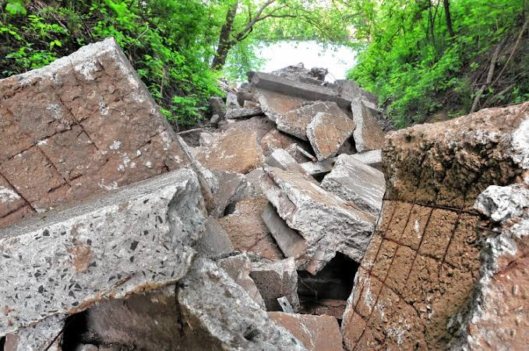

Slide 7
RAPID CONSTRUCTION
Out of the total construction the demolition waste contains 40% of concrete,30% of ceramics,5% of plastic,10% of wood,5% of metal and 10% of other mixtures as reported by global insight , growth in global construction sector predicts an increase in constructions spending of 4800 billions US dollars in 2013.These figures indicates a tremendous growth in construction sector , almost 1.5 times in 5 years .For production of concrete,72-75% of aggregates are required .Out of this 60-67% is of coarse aggregate and 33-40% is of fine aggregate. As per research by Fredonia group , it forecast that the global demand for construction the aggregates may exceed 26billion tons by 2012.
The of recycled aggregate generally increases the drying shrinkage , creep , porosity of water and decreases the compression strength of concrete compared to that of natural aggregate of concrete . It is nearly 10-30% as per replacement of aggregate.

Slide 8
If same rate of construction continues….
WHAT WILL HAPPENS AT 2050?
No any natural aggregates
MEANS
No one can construct any Buildings, Bridges, Dams, Roads, Pavements……..

Slide 9

ARE NATURAL AGGREGATES ENOUGH FOR FUTURE CONSTRUCTION ???

Slide 10

NO NATURAL AGGREGATE
=
NO CONSTRUCTION
NO JOBS FOR CIVIL ENGINEERS

Slide 11
INTRODUCING RECYCLED CONCRETE AGGREGATE
The final product collected from crushing and separated from contamination obtained from construction and demolition wastes such as concrete waste, broken bricks, bridge supports, road pavements, concrete road beds etc . that has been previously used in construction are recycled aggregate

Slide 12
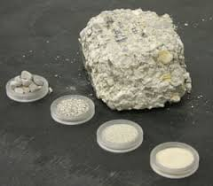
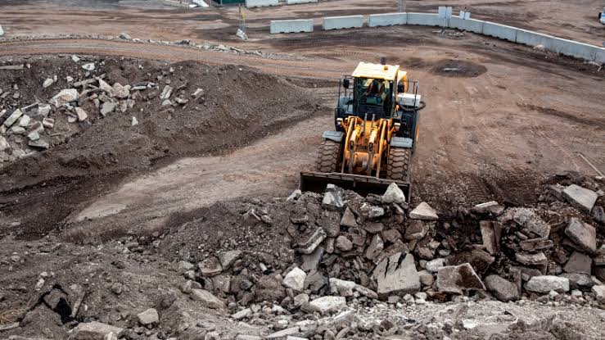

Slide 13
BENEFITS OF RECYCLING CONCRETE AGGREGATE
Conserve diminishing NATURAL AGGREGATE RESOURCES
Use of CONSTRUCTION WASTES
Protection of ENVIRONMENT
Save MONEY
Create additional BUSINESS OPPORTUNITIES

Slide 14
PROPERTIES AND EXPERIMENTAL VERIFICATION
PARTICLE SIZE DISTRIBUTION
Sieve analysis is done after crushing and sieving as per IS code 2386 to separate out coarse and fine aggregate
Recycled aggregate meets all the standard requirements of natural aggregate
SPECIFIC GRAVITY AND WATER ABSORPTION
Sp.gravity(saturated surface dry condition) of recycled concrete aggregate(RCA) was found from 2.35 to 2.58 which is slightly lower than natural aggregate
Water absorption ranges 3.05% to 7.40% which is slightly higher than that of natural aggregate
MODULUS OF ELASTICITY
RCA has lower than NAC upto 15% only
It can be increased if hardened cement paste adhere to aggregate are removed well

Slide 15
Compressive strength
The average compressive strengths cube cast are determined as per IS 516 using RCA and natural aggregate at age 1,3,7,14,28,56and 90 days.
Reduction in strength of RCA as compered to NCA
CRUSHING VALUES AND IMPACT VALUES
As per IS 2386 , the crushing & impact values for concrete , wearing surfaces should not exceed 45% and 50% respectively.
RAC satisfy the BIS specifications.

Slide 16
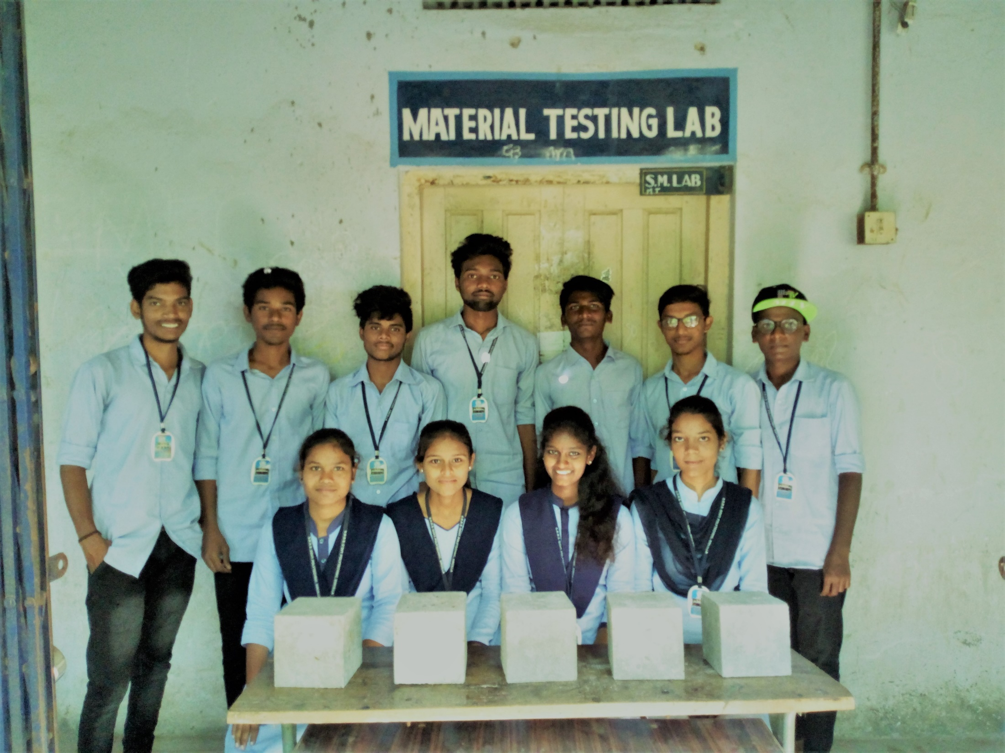

Slide 17
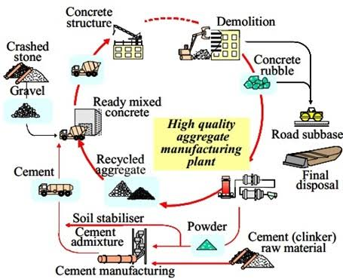

Slide 18
conclusion
The use of recycled concrete aggregate is proved to be a valuable , building materials in technical, environmental & economical respects.
Recycle & reuse is an appropriate solution to problems of dumping hundred of thousands of tons of demolition wastes
However , more reserch and initiation of piollt project for application of RCA is started for modifying our design codes , specifications & procedure for use of RCA

Slide 19
Thank you
PRESENTED BY
B.Ruchitha (17024-c-239)
R.Abhishek (17024-c-202)
A.Akhil (17024-c-204)
G.Nagesh (17024-c-255)
P.Aarthi (17024-c-256)
J.Nanda gopal (17024-c-223)
V.Rakesh (17024-c-234)
B.Bhavani (17024-c-212)
P.Hrushikesh (17024-c-217)
CH.Anjaneyulu (17024-c-207)
O.Ravali (17024-c-237)
K.Akshay kumar (17024-c-503)

Slide 20
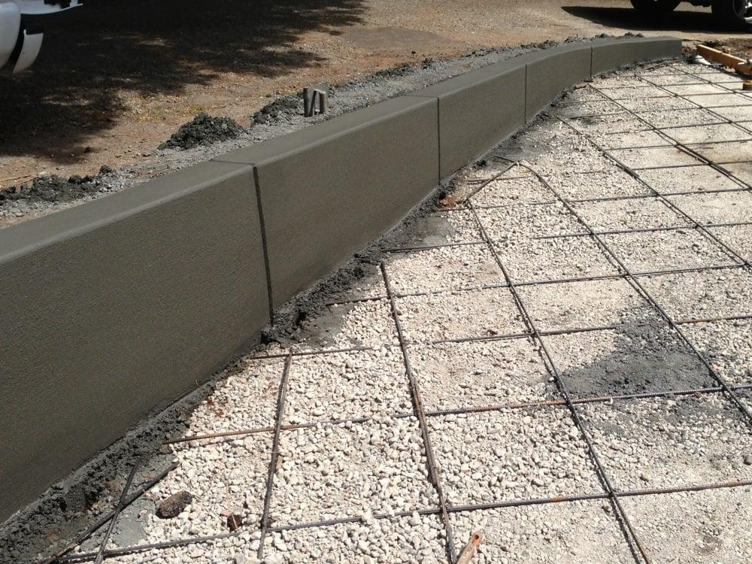

Slide 21

THANK YOU…!

